Slide 1

Case Records of the Massachusetts General Hospital
Case 17-2025: A 61-Year-Old Man with Respiratory Failure and Shock after Kidney Transplantation
N Engl J Med
Volume 392(23):2368-2378
June 19, 2025

Slide 2
Presentation of Case

Slide 3
A 61-year-old man was transferred to this hospital because of acute hypoxemic respiratory failure and shock.
Ten weeks earlier, the patient had undergone deceased-donor kidney transplantation at this hospital for hypertensive nephrosclerosis-related end-stage kidney disease. After transplantation, the patient’s hospitalization was notable for the administration of antithymocyte globulin induction therapy; delayed graft function with hyperkalemia, for which he underwent two sessions of hemodialysis; and urinary retention. On postoperative day 4, he was discharged home with instructions to take oral prednisone, tacrolimus, mycophenolate sodium, trimethoprim–sulfamethoxazole, and valganciclovir.

Slide 4
The patient’s medical history included hypertension, type 2 diabetes mellitus, hyperlipidemia, coronary calcifications, ectasia of the aorta, hyperparathyroidism for which he had undergone parathyroidectomy, obstructive sleep apnea, kyphoplasty at the level of the first lumbar vertebra, and repair and internal fixation of a left ankle fracture. The patient had been undergoing hemodialysis for 6 years while awaiting kidney transplantation. Outpatient medications included oral prednisone, tacrolimus, mycophenolate sodium, trimethoprim–sulfamethoxazole, valganciclovir, furosemide, labetalol, famotidine, and tamsulosin, as well as subcutaneous semaglutide. Atenolol had caused constipation, and amitriptyline had caused dry mouth.

Slide 5
Six weeks after transplantation (4 weeks before the current admission), during a follow-up visit in the transplantation clinic, the creatinine level was 1.60 mg per deciliter (141 μmol per liter; reference range, 0.60 to 1.50 mg per deciliter [53 to 133 μmol per liter]); however, hyperglycemia was noted, with a glycated hemoglobin level of 7.7% (reference value, <5.7). Treatment with a once-weekly injection of semaglutide was started.

Slide 6
One week later, the patient was evaluated at the emergency department of another hospital for erythema and swelling of the left ankle after being scratched by a domestic cat. A radiograph of the ankle reportedly showed soft-tissue swelling. A course of amoxicillin–clavulanate was prescribed.
During the next week, the patient began to have fatigue, nausea, emesis, polydipsia, and polyuria. Outpatient laboratory test results were notable for a glucose level of 519 mg per deciliter (29 mmol per liter; reference range, 70 to 100 mg per deciliter [3.9 to 5.6 mmol per liter]). At the recommendation of the transplantation team, he was admitted to the other hospital.

Slide 7
On arrival at the other hospital, 10 days before the current admission, the oral temperature was 36.8°C, the heart rate 108 beats per minute, the blood pressure 127/74 mm Hg, the respiratory rate 26 breaths per minute, and the oxygen saturation 97% while the patient was breathing ambient air. The weight was 105.7 kg. Electrocardiography reportedly showed sinus tachycardia with premature atrial contractions. Intravenous normal saline and insulin were administered.

Slide 8
In addition to dyspnea, the patient had had nausea, anorexia, progressive abdominal discomfort, and intermittent emesis, and he was currently not having bowel movements. He also had dull headache and low back pain. He did not have chest pain, palpitations, dizziness, pain or redness at the surgical incision site, or bleeding symptoms.

Slide 9
On the fifth day of hospitalization, the oxygen saturation had decreased to 93% while the patient was breathing ambient air, and supplemental oxygen was administered intermittently. Nausea persisted with intermittent episodes of emesis and inability to eat.

Slide 10
On the seventh day of hospitalization, the administration of labetalol — a medication that the patient had been taking at home — was discontinued because the blood pressure had decreased to 84/48 mm Hg and the heart rate had increased to more than 120 beats per minute.
On the eighth day of hospitalization, a cough productive of white sputum developed, and dyspnea, which had also developed, had progressed such that it occurred with less exertion and when the patient was at rest.

Slide 11
The patient began to have tachypnea (up to 38 breaths per minute) with accessory-muscle use, and the oxygen saturation was 96% while the patient was receiving supplemental oxygen through a nasal cannula at a rate of 6 liters per minute. Oxygen was subsequently administered through a high-flow nasal cannula, and the patient was transferred to the intensive care unit (ICU). Specimens of blood and tracheal aspirate were obtained for culture. Empirical treatment with piperacillin–tazobactam was administered intravenously.

Slide 12
The next day, the patient became lethargic and more hypoxemic; the oxygen saturation was 96% while the patient was receiving supplemental oxygen through a high-flow nasal cannula at a rate of 40 liters per minute. The trachea was intubated for initiation of mechanical ventilation. The blood pressure decreased to 81/53 mm Hg; lactated Ringer’s solution was administered intravenously, and a central venous catheter was placed for administration of norepinephrine.

Slide 13
On examination, the esophageal temperature was 38.1°C, the heart rate 123 beats per minute, and the blood pressure 114/58 mm Hg while the patient was receiving infusions of norepinephrine at a rate of 36 μg per minute and vasopressin. The weight was 109.0 kg. The oxygen saturation was 97% while he was receiving oxygen through a mechanical ventilator in volume-control mode (tidal volume, 500 ml at a rate of 20 breaths per minute; positive end-expiratory pressure, 8 cm of water; fraction of inspired oxygen, 0.50).

Slide 14
No oral mucosal lesions were present. Auscultation of the chest revealed diffuse crackles in the lungs. The heart was tachycardic. The abdomen was distended and tense, with few bowel sounds. The kidney allograft site in the right lower quadrant was non erythematous; no bruit was detected. A purpuric rash was present on the abdomen. An arteriovenous fistula in the left upper arm was associated with a weak thrill and bruit. Symmetric leg edema was present.

Slide 15
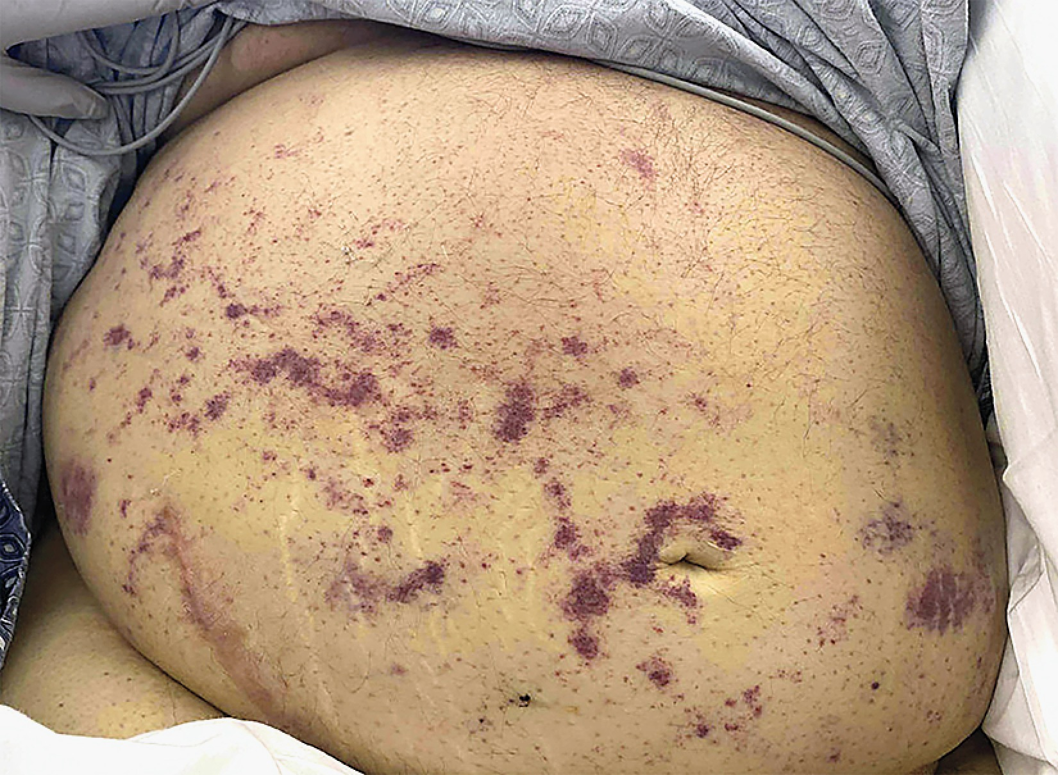
Notes:
Figure 2 Photograph of Abdominal Rash. A photograph obtained on admission to the intensive care unit at this hospital shows a purpuric rash on the abdomen.

Slide 16
DDX?

Slide 17
Para-Clinics

Slide 18
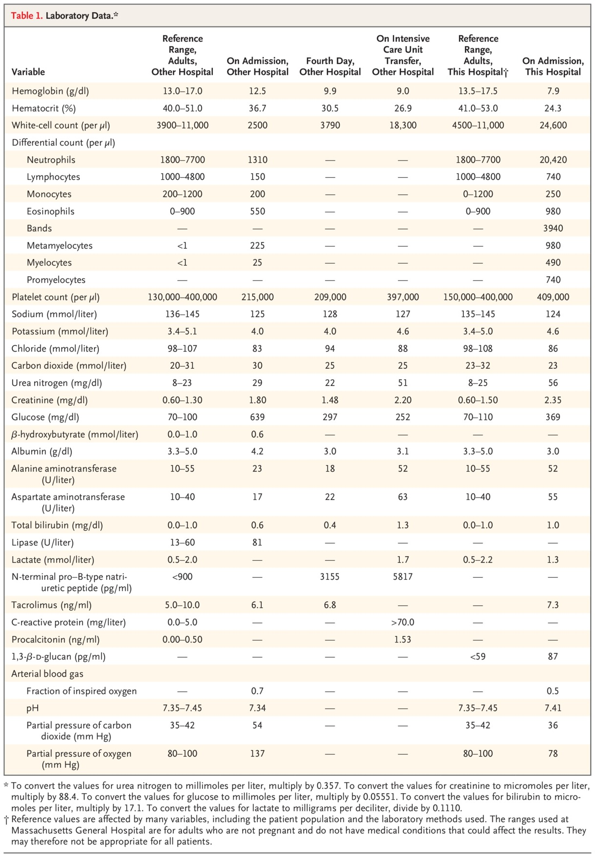
Kotton CN et al. N Engl J Med2025;392:2368-2378
Notes:
Table 1 Laboratory Data.

Slide 19
Echocardiography
Transthoracic echocardiography reportedly showed normal ventricular function, left ventricular hypertrophy, left atrial enlargement, an inferior vena cava with respirophasic collapse, and mild thickening of the aortic and mitral valves.

Slide 20
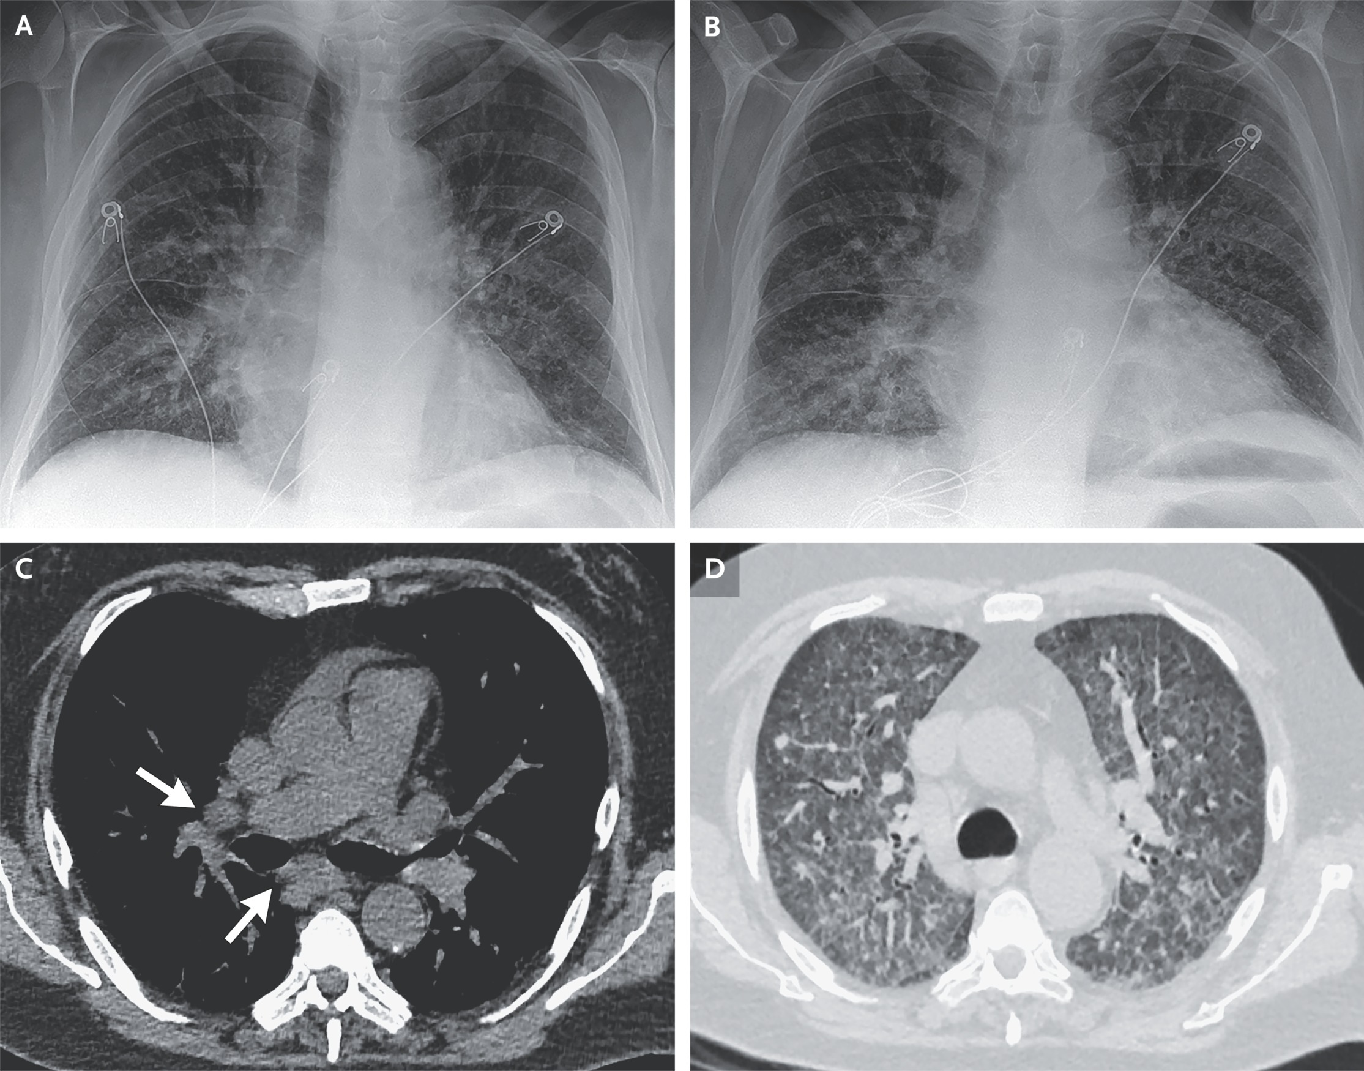
Notes:
Figure 1 Initial Imaging Studies of the Chest Obtained at the Other Hospital. A posteroanterior chest radiograph obtained on the 9th day of hospitalization at the other hospital (Panel A) shows fullness in the hila, indistinctness of the pulmonary vasculature, thickening of the minor fissure, and peripheral interlobular septal thickening. A posteroanterior chest radiograph obtained on the 10th day of hospitalization at the other hospital (Panel B) shows mildly increased pulmonary edema. On the same day, axial projection CT images, obtained without the administration of contrast material, in soft-tissue and lung windows show mediastinal and hilar lymphadenopathy (Panel C, arrows) and diffuse ground-glass opacities and interlobular thickening (Panel D).

Slide 21
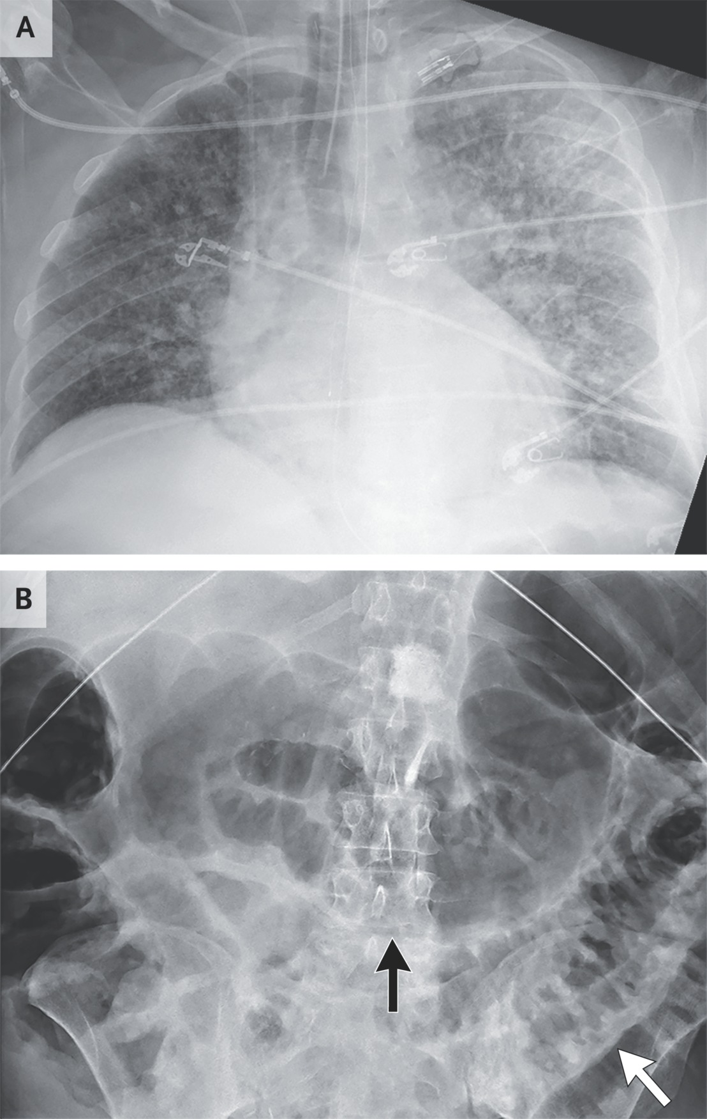
Notes:
Figure 3 Radiographs of the Chest and Abdomen Obtained at This Hospital. An anteroposterior chest radiograph obtained while the trachea was intubated (Panel A) is notable for increased pulmonary edema, and an abdominal radiograph obtained on the same day (Panel B) shows diffuse gaseous distention of the small bowel (white arrow) and large bowel (black arrow).

Slide 22
Problem List
progressively worsening acute kidney injury, leukocytosis, eosinophilia, volume overload, emesis, ileus, and abdominal pain. Chest imaging was notable for extensive interstitial and ground-glass opacities and mediastinal and hilar lymphadenopathy.

Slide 23
DDX?

Slide 24
DDX List
nosocomial infection
surgical site infection
community-acquired infection (especially given the patient’s cat scratch 2 weeks earlier)
opportunistic infection
reactivation of latent infection
organ donor–derived or transfusion-derived infection.

Slide 25
Pathological Discussion

Slide 26
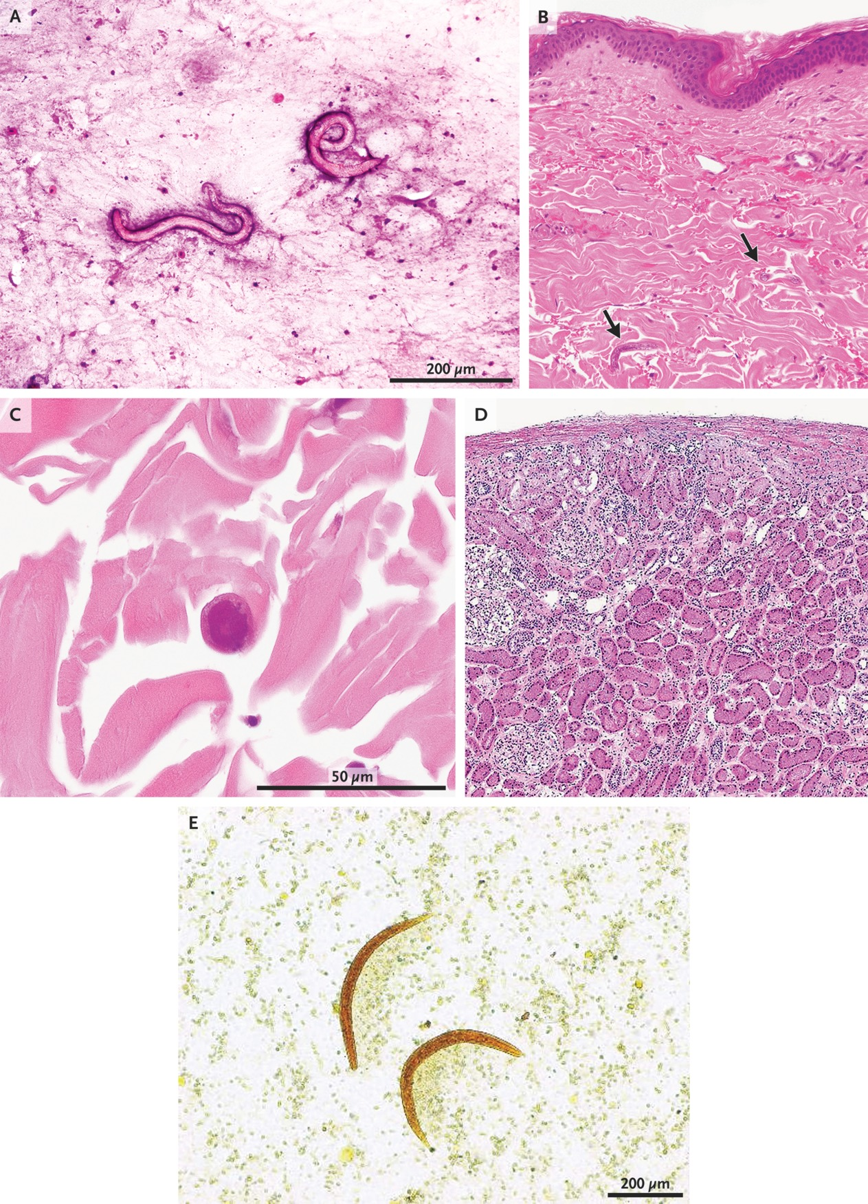
Tracheal Aspirate and Biopsy Specimens and a Stool Specimen.
Notes:
Figure 4 Tracheal Aspirate and Biopsy Specimens and a Stool Specimen. Tracheal aspirate and biopsy specimens were obtained on admission to this hospital. Gram’s staining of the tracheal aspirate (Panel A) shows two larval forms with rounded heads and tapered tails, measuring approximately 250 to 300 microns in length and 18 to 25 microns in width, in a background of numerous eosinophils. Hematoxylin and eosin staining of a 4-mm punch-biopsy specimen of skin from the abdominal rash (Panels B and C) shows larvae (Panel B, arrows) infiltrating the dermal collagen with minimal inflammation. At higher magnification (Panel C), the larvae are seen in cross section, surrounded by dermal collagen. Hematoxylin and eosin staining of a frozen section of the wedge-biopsy specimen that had been obtained from the donated kidney at the time of transplantation (Panel D) shows cortical renal parenchyma with no specific pathological abnormality. A stool specimen was obtained from the second kidney-transplant recipient, who had received the deceased donor’s other kidney. An iodine preparation of the stool specimen (Panel E) confirms the diagnosis of strongyloidiasis in the second kidney-transplant recipient.

Slide 27
Subsequent bronchoscopy and aspiration of tracheal secretions were performed at this hospital. Gram’s staining of the tracheal aspirate showed numerous white cells, including many eosinophils, and scattered roundworm larval forms with rounded heads and tapered tails. A majority of the larvae measured approximately 250 to 300 microns in length and 18 to 25 microns in width, consistent with first- and second-stage rhabditiform larvae of Strongyloides stercoralis.

Slide 28
Three days later, a 4-mm punch biopsy of skin from the site of the patient’s abdominal rash was performed. Histologic examination of the punch-biopsy specimen revealed scattered roundworms in the dermal collagen with minimal inflammation. The exact length of the worms could not be measured owing to the cross-sectional nature of the histologic preparation; however, the larval forms were found to measure 12.5 microns in width, consistent with third-stage filariform larvae of S. stercoralis.

Slide 29
The presence of larval forms in the pulmonary system alone expands the differential diagnosis to include recent infection by a hookworm or by Ascaris lumbricoides. However, the presence of the larval forms in both the lungs and the skin, together with the observed morphologic and size characteristics, is diagnostic of disseminated strongyloidiasis.

Slide 30
Final Diagnosis
Donor-Derived Disseminated strongyloidiasis.

Slide 31
Treatment of Disseminated Strongyloidiasis

Slide 32
We were able to treat this patient with oral ivermectin at a dose of 21 mg per day plus subcutaneous ivermectin at a dose of 21 mg per day (separated by 12 hours), along with albendazole at a dose of 400 mg every 12 hours, for 1 month. In addition, vancomycin and meropenem were administered owing to the patient’s high risk of bacteremia given the presence of the migratory parasites.

Slide 33
Because ivermectin predominantly treats intraluminal intestinal parasites, we decided to continue treatment with oral ivermectin in once-monthly doses for 6 months, after the full month-long course of treatment was completed. Since coinfection with human T-lymphotropic virus type 1 (HTLV-1) decreases the ability of the immune system to clear strongyloides, a blood test for HTLV-1 was performed in this patient and was negative.

Slide 34
Thanks For Your Attention

